Slide 1
Bidirectional Path Tracing & Progressive Photon Mapping
Xiangzheng Mao, cs184-afn
Ian Marshall, cs184-aby

Slide 2
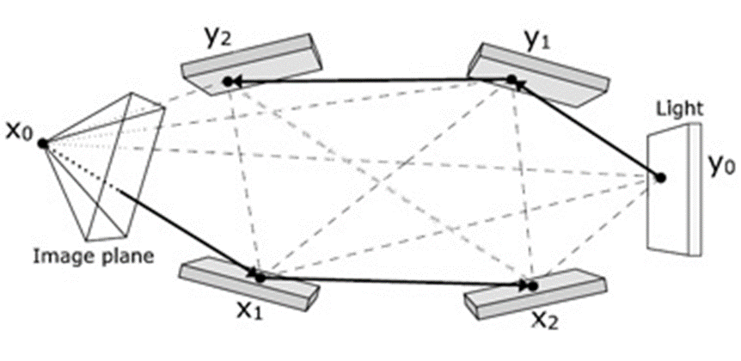
Bidirectional Path Tracing
1. Trace paths from both the eye and the light to form the eye path and the light path
2. Connect every pair of vertexes across the eye path and the light path to form complete paths
3. Accumulate weighted contributions of sampled complete paths to the pixels they intersect on the image plane
Path tracing: 0 or 1 vertex on the light path
Light tracing: 0 or 1 vertex on the eye path

Slide 3
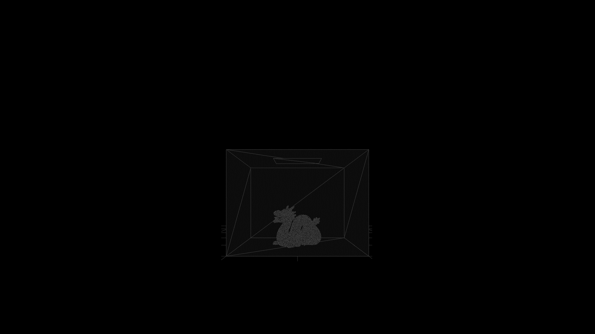
BDPT in Action

Slide 4
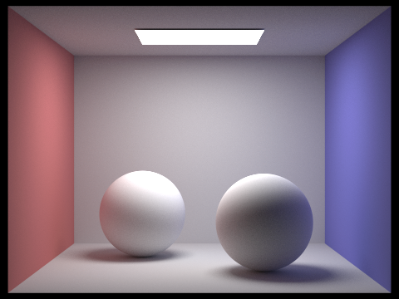


PT, LT, and BDPT
Diffuse spheres
PT, 1024 spp
Diffuse spheres
LT, 1024 spp
Diffuse spheres
BDPT, 1024 spp
They all converge to the same image with enough samples per pixel
(assuming no specular materials)

Slide 5
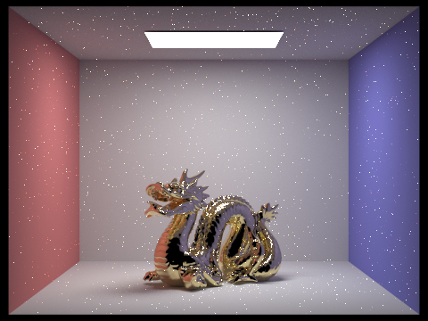
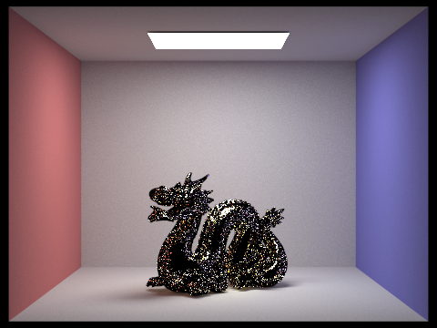
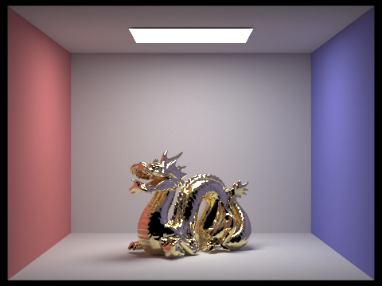
PT, LT, and BDPT
Microfacet dragon with alpha = 0.005
PT, 1024 spp
Microfacet dragon with alpha = 0.005
LT, 1024 spp
Microfacet dragon with alpha = 0.005
BDPT, 1024 spp
BDPT combines the strengths of PT and LT,
and is good at rendering microfacet materials and caustics

Slide 6
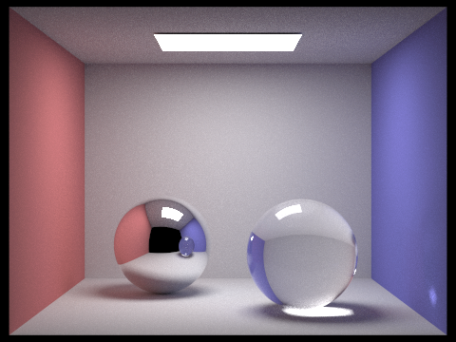
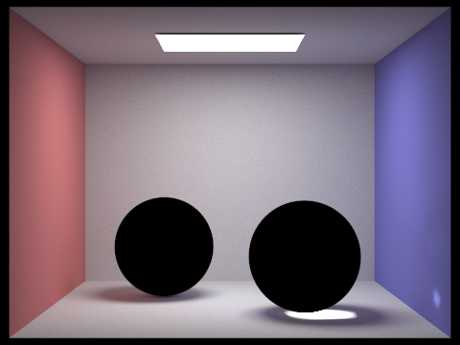

PT, LT, and BDPT
Specular spheres
PT, 1024 spp
Specular spheres
LT, 1024 spp
Specular spheres
BDPT, 1024 spp
BDPT combines the strengths of PT and LT,
and is good at rendering microfacet materials and caustics

Slide 7
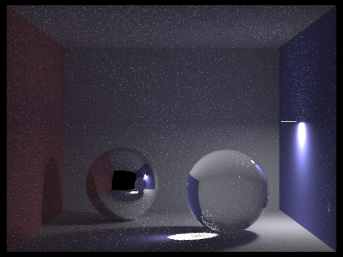
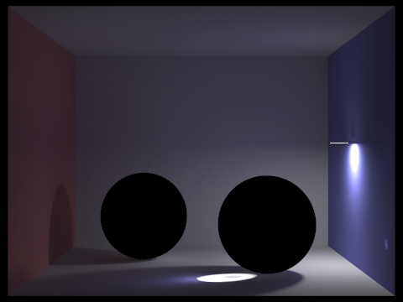

However ...
Specular spheres (harder)
PT, 1024 spp
Specular spheres (harder)
LT, 1024 spp
Specular spheres (harder)
BDPT, 1024 spp
BDPT is not good at rendering reflected caustics,
because it does not handle specular-diffuse-specular (SDS) paths well

Slide 8
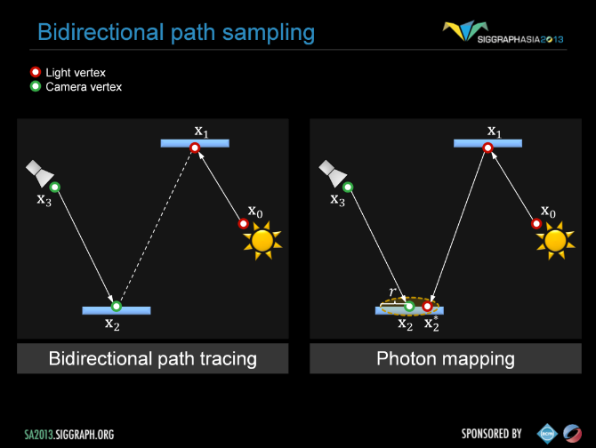
Progressive Photon Mapping
Photon Mapping is good at handling SDS paths because it merges vertexes rather than connecting them
Progressive photon mapping progressively reduces merging radii to handle the blurring problem of PM

Slide 9
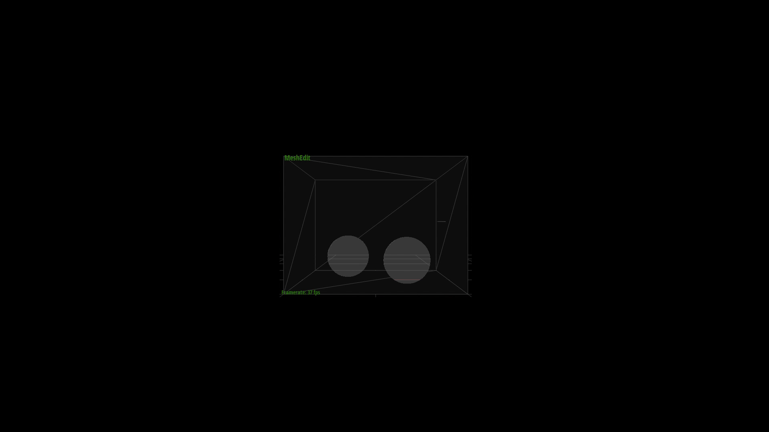
BDPT+PPM in Action

Slide 10
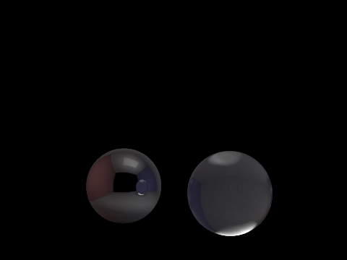

PT, LT, PPM, and BDPT+PPM
Specular spheres
PT, 1024 spp
Specular spheres
LT, 1024 spp
Specular spheres
(SDS paths only)
PPM, 10^8 photons
Specular spheres
BDPT+PPM
1024 spp
10^8 photons

Slide 11
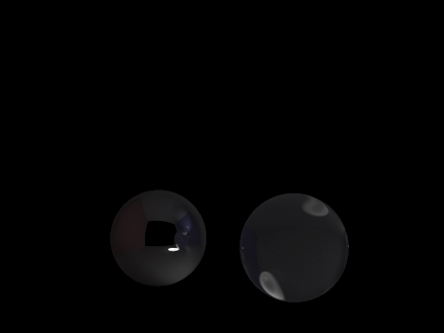

PT, LT, PPM, and BDPT+PPM
Specular spheres
(harder)
PT, 1024 spp
Specular spheres
(harder)
LT, 1024 spp
Specular spheres
(harder)
(SDS paths only)
PPM, 10^8 photons
Specular spheres
(harder)
BDPT+PPM
1024 spp
10^8 photons

Slide 12
Final Results Gallery
Diffuse spheres
BDPT, 1024 spp
Microfacet dragon with alpha = 0.005
BDPT, 1024 spp
Specular spheres
BDPT+PPM
1024 spp
10^8 photons
Specular spheres
(harder)
BDPT+PPM
1024 spp
10^8 photons

Slide 13
References
Veach, E. (1997). Robust monte carlo methods for light transport simulation (Doctoral dissertation, Stanford University).
Hachisuka, T., Ogaki, S., & Jensen, H. W. (2008). Progressive photon mapping. ACM Transactions on Graphics (TOG), 27(5), 130.

